Slide 1

ROAD ACCIDENT ANALYSIS
Steering Towards A Safer Future

Slide 2

Objective
Identify patterns and trends in accident data to develop proactive measures and policies for accident prevention.
Analyze data to identify key contributing factors to accidents, such as weather conditions, time of day, and road infrastructure, for targeted prevention strategies.
Study seasonal variations in accident rates to implement season-specific awareness campaigns and safety measures.
Encourage stakeholders to make informed decisions by leveraging the insights derived from the road accident analysis dashboard.

Slide 3
Data Munging:
Cleaned the data by removing empty rows, removed spelling errors and changed data types of the required fields.
Created another table called ‘Calendar’ because the main Data table contains many accidents on the same date which will lead to some errors in the calculation.
Established a relationship between Calendar and Data table.

Slide 4
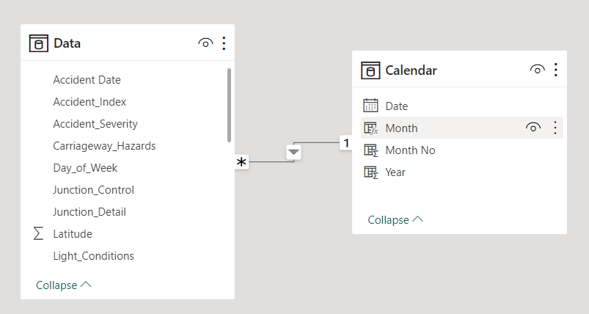
Creation of Calendar table:
Data Modelling:

Slide 5
Creating Measures
CY Accidents
PY Accidents
YOY Accidents

Slide 6
Creating Measures
CY Casualities
PY Casualities
YOY Casualities

Slide 7
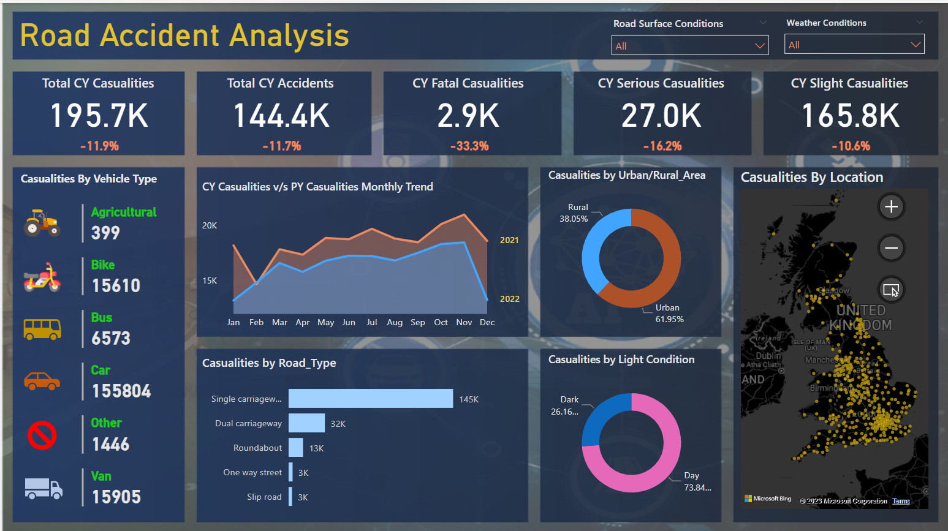

Slide 8
Conclusion
From the visualisation it can be seen that number of casualities and number of accidents has been significantly reduced from previous year.
Visualisations indicate that there are more casualties during the day than at night.
Visualisations indicate that urban areas experience a higher number of casualties than rural ones.
When it comes to vehicle categories, cars inflict the most casualties, followed by vans and bikes.

Slide 9
THANK YOU

